Slide 1

Autonomous Real-Time Interactive Architecture

Slide 2
Overview
Context
Objectives
Demo
Technical Details
Project Roadmap
Meeting Objectives - Engineering Practices

Slide 3
Project Context

Slide 4
Smart Home
Oxford Dictionary:
“A home equipped with lighting, heating, and electronic devices that can be controlled remotely by smartphone or computer”^{[1]}

Slide 5
Machine Learning
Oxford Dictionary:
“The capacity of a computer to learn from experience, i.e. to modify its processing on the basis of newly acquired information” ^{[2]}

Slide 6





Existing Home Automation

Slide 7
Motivation
Why do people use home automation?
What problems can people use home automation to solve?

Slide 8
Project Objectives

Slide 9
Project Scope
Monitoring
Controlling
Learning

Slide 10
Demo

Slide 11
Technical Details

Slide 12
Scenarios
Device Interaction
Feature Extraction
Learning Behaviours

Slide 13

Use Cases

Slide 14
Non-Functional Requirements
What major properties should be accounted for in system design?
Performance
Security
Testability
Modifiability

Slide 15




Communication Protocols

Slide 16
Protocol Comparison
Protocol | Transfer Rate | Battery Life | Frequency | Range | Topology
Zigbee | 250 Kbps | Good | 2.4 GHz | 35 ft. | Mesh
Z-Wave | 40 Kbps | Great | 915 MHz | 100 ft. | Mesh
Insteon | 13 Kbps | Good | 915 Mhz | 150 ft. | Mesh
WiFi | 54 Mbps | Bad | 2.4 GHz / 5.0 Ghz | 105 ft. | Star
BLE | 10 Kbps | Good | 2.4 Ghz | 200 ft. | Star

Slide 17

System Design
Persistence
Logic
Presentation

Slide 18



Data Storage

Slide 19
Project Roadmap

Slide 20
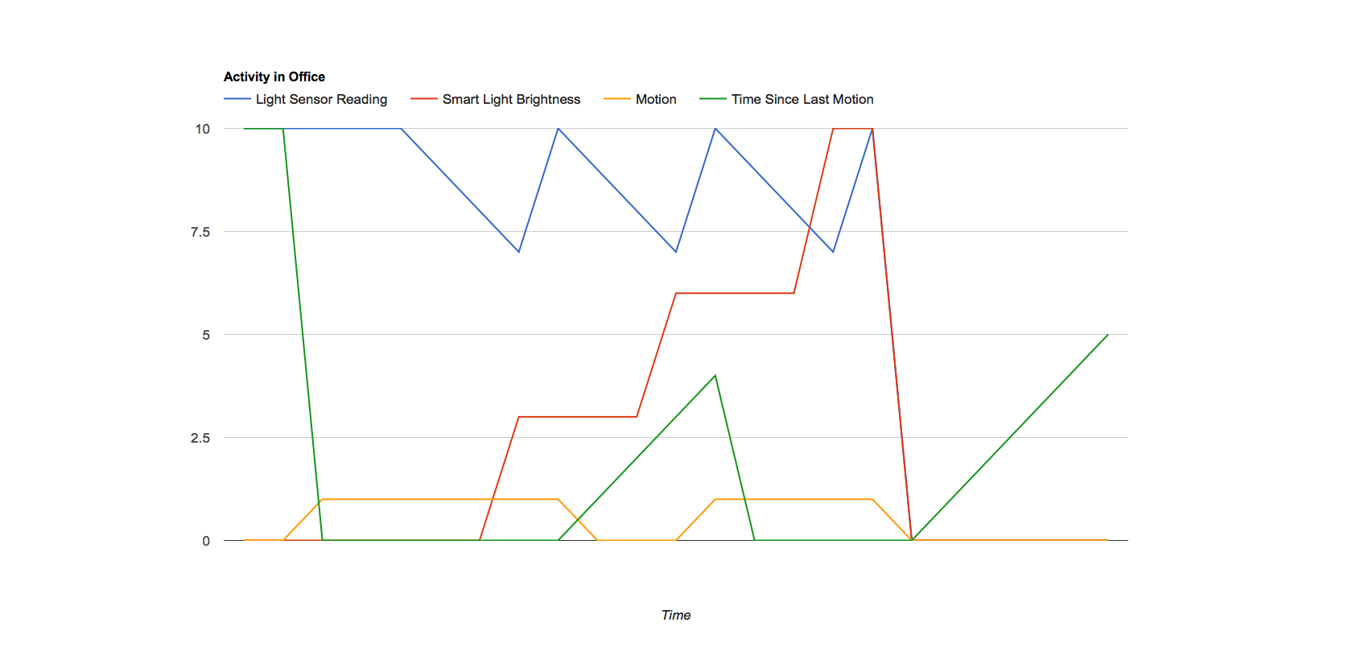
System Statistics

Slide 21
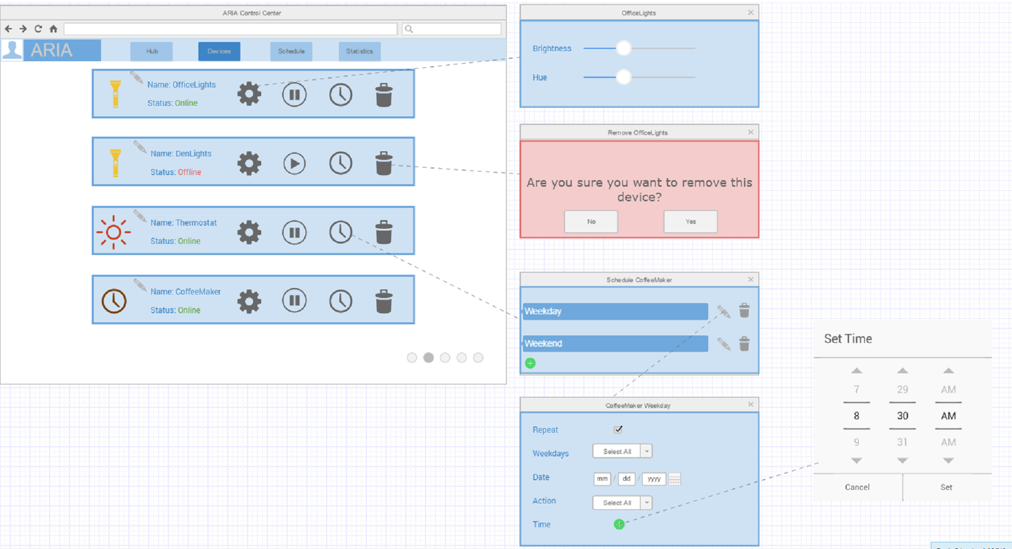
Scheduling

Slide 22
Machine Learning
Which algorithms have we considered?
Which algorithm are we planning to implement?

Slide 23
Meeting Objectives

Slide 24

Code Lifecycle

Slide 25
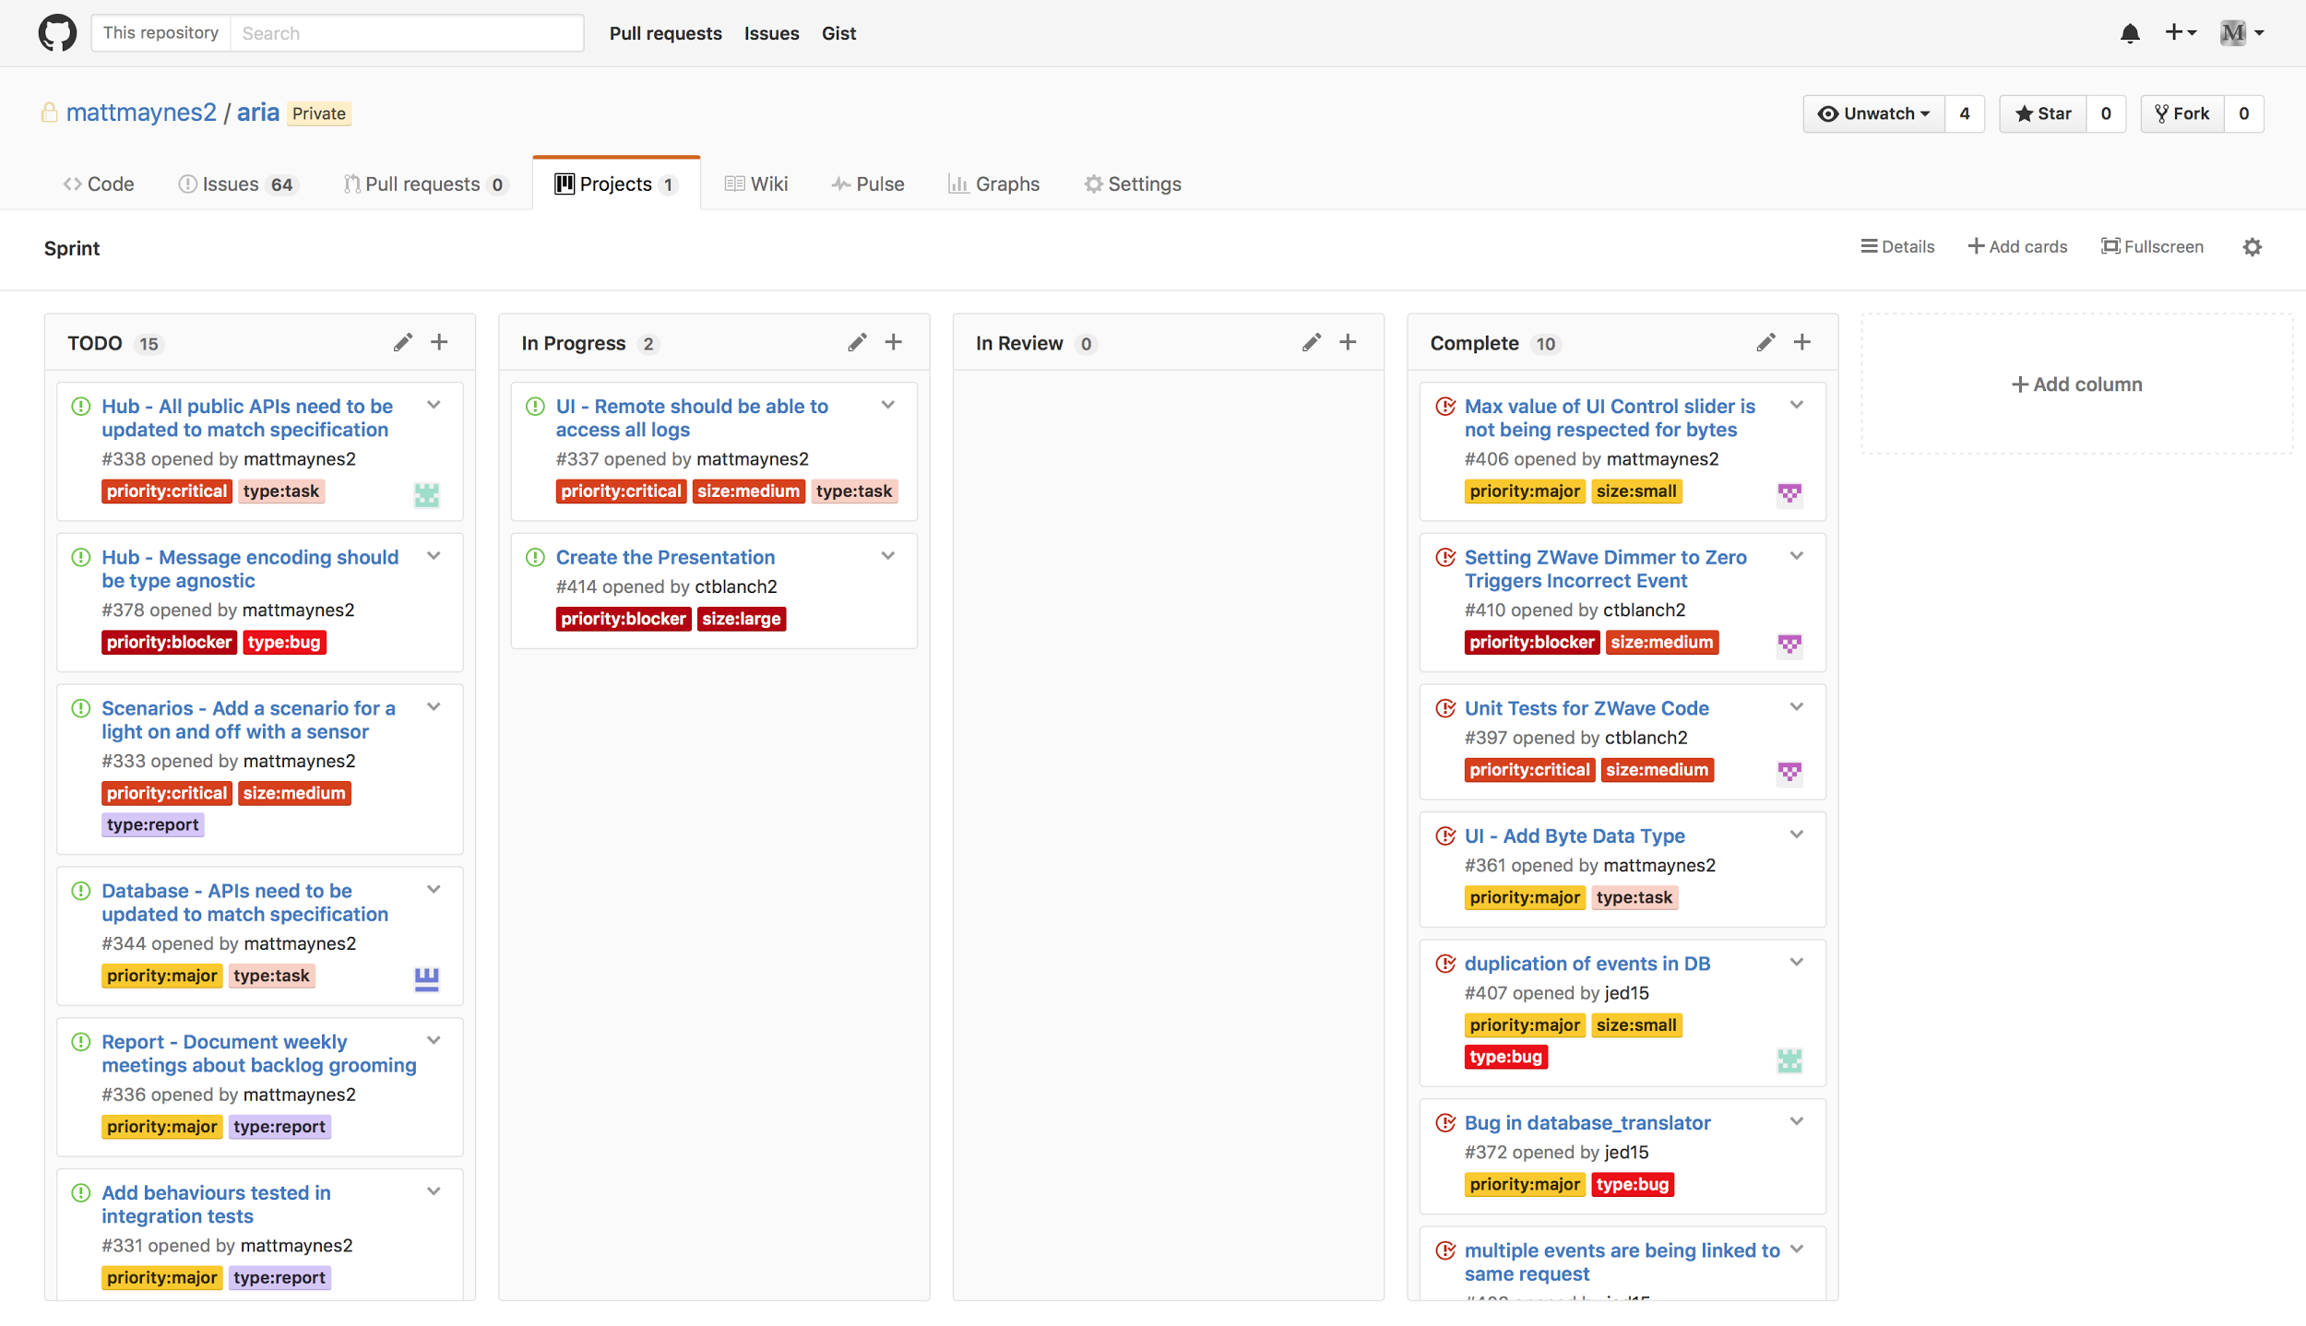
Sprint Tasks

Slide 26
Code Lifecycle

Slide 27
Summary
Where are we?
Where we want to go?
Autonomous Real-Time Interactive Architecture

Slide 28
Questions?

Slide 29
References
[1] "smart home," in Oxford English Dictionary Online, 2016. [Online]. Available: https://en.oxforddictionaries.com/definition/smart_home. Accessed: Jan. 15, 2017.
[2] "machine learning," in Oxford English Dictionary Online, 2016. [Online]. Available: https://en.oxforddictionaries.com/definition/machine_learning. Accessed: Jan. 15, 2017.

